Slide 1

PriceTrendAgent
Yuta Kawasaki, Ryuta Shiraishi, Keiichi Namikoshi
Nagoya Institute of Technology
Notes:
Hello, I’m Yuta Kawasaki from Nagoya Institute of Technology.
I’m going to introduce our proposed agent called PriceTrendAgent for ANAC-2025 competition.
This is a joint work with Ryuta Shiraishi and Keiichi Namikoshi.​

Slide 2
PriceTrendAgent | 4th Place-Standard
We developed PriceTrendAgent for Supply Chain Management League (Standard Track).
Our agent is based on CautiousStdAgent,
which placed 2nd in the 2024 Standard Track.
Our agent finished 4th in the 2025 Standard Track.
Notes:
This slide presents an overview of our agent.
We developed PriceTrendAgent based on the CautiousStdAgent, which placed 2nd in the 2024 Standard Track.
Our agent finished 4th in the 2025 Standard Track.

Slide 3
Ideas of PriceTrendAgent
Idea 1 : Partner scoring
  Our agent updates the partner’s score based on
  price and quantity.
Idea 2 : Market trend prediction
  It uses a market prices to predict subsequent movement.
Idea 3 : Trend-aware proposal adjustments
  It adjusts proposal quantity and timing based on
  market trend.
Notes:
This slide summarizes our ideas.
There are three key points.
First, partner scoring.
Our agent updates the partner’s score based on price and quantity.(E)
Second, market trend prediction.
Our agent uses a market prices to predict subsequent movement.(E)
Third, trend-aware proposal adjustments.
Using that trend, the agent adjusts proposal quantity and timing based on
market trend.

Slide 4


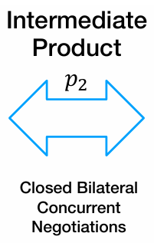
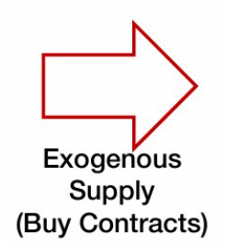
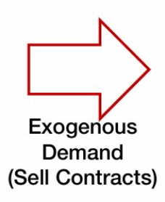

Overview : Partner Scoring (idea 1)
Ideas
PriceTrendAgent scores each trading partner based on past negotiations.
Partner scoring
Market trend prediction
Trend-aware proposal adjustments
Market Price : XX
①
Notes:
Now, using this figure, I’ll give an overview of the three ideas.
In partner scoring,(E) PriceTrendAgent derives each trading partner’s score based on the transaction details.

Slide 5
Overview : Market Trend Prediction (idea 2)
Ideas
Partner scoring
Market trend prediction
Trend-aware proposal adjustments
PriceTrendAgent monitors market prices and predicts price trends.
Market Price : XX
②
Notes:
In market trend prediction, (E)PriceTrendAgent monitors market prices, uses an exponential moving average (EMA), and predicts price trends.

Slide 6

Overview : Trend-aware Proposal Adjustments (idea 3)
Ideas
Partner scoring
Market trend prediction
Trend-aware proposal adjustments
PriceTrendAgent adjusts its proposals based on the earlier predictions.
Market Price : XX
③
Notes:
In trend-aware proposal adjustments, (E)PriceTrendAgent adjusts the quantity and timing of its proposals based on the trend predictions.

Slide 7
Partner Scoring (idea 1)
Improvements
Partner scoring
Market trend prediction
Trend-aware proposal adjustments
PriceTrendAgent scores each trading partner based on past negotiations.
Market Price : XX
②
①
③
Notes:
I’d like to explain the details of Partner Scoring.

Slide 8
Detail of Partner Scoring
Our agent assigns each partner a priority value based on a score derived from past successful negotiations.
It’s determined by normalized price score,
normalized quantity score, and past cumulative score.
Focuses on the highest-scoring partners for negotiation by shifting from equal to prioritized allocation.
Notes:
Our agent derives a partner score for each counterparty and uses it as a priority index.
This score comes from three parts: normalized price score, normalized quantity score, and past cumulative score.
In the second half of the process, the agent shifts from equal allocation to prioritized allocation, focusing on the highest-scoring partners.
何のためのスコアなのか：交渉相手に優先度を定め，効率よく交渉を進めるため
スコアの計算方法：正規化した取引価格，取引量，過去の取引内容から計算
スコアをどう利用するのか：スコアの高い取引相手に優先して取引をする

Slide 9
Market Trend Prediction (idea 2)
Improvements
Partner scoring
Market trend prediction
Trend-aware proposal adjustments
PriceTrendAgent monitors market prices and predicts price trends.
Market Price : XX
②
①
③
Notes:
Next, I will explain Market Trend Prediction.

Slide 10


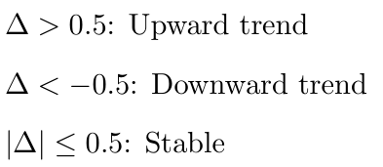
Detail of Market Trend Prediction
Our agent monitors the price trend in the market.
The agent predicts price trends using
exponential moving averages (EMA).
Classifies trend by difference :
The agent uses this prediction to adjust proposals.
Notes:
First, PriceTrendAgent monitors the average input product prices from the SCML environment at each step.
It then calculates an Exponential Moving Average, or EMA.
Next, it calculates the difference between the current price and the EMA.
If the difference is greater than 0.5, we call it an upward trend.
If it is less than minus 0.5, we call it a downward trend.
Otherwise, it is stable.
The agent uses this prediction to adjust proposals.
市場トレンドの判定方法：
トレンド予測には市場価格を使用．
市場価格の変化量ごとにトレンドを判定．
平滑移動平均(EMA)を使用し，安定化を図る．
スコアをどう利用するのか：提案内容の調整に使用（次のスライドで説明）

Slide 11
Trend-Aware Proposal Adjustments (idea 3)
Improvements
Partner scoring
Market trend prediction
Trend-aware proposal adjustments
PriceTrendAgent adjusts its proposals based on the earlier predictions.
Market Price : XX
②
①
③
Notes:
Finally, I will explain Trend-Aware Proposal Adjustments.

Slide 12
Detail of Trend-Aware Proposal Adjustments
The agent changes proposal timing and quantity depending on the market trend Δ (idea 2).​
Timing adjustment:
  Upward : Keep proposal as is (To avoid higher prices)
  Downward : Delay proposal date (To wait for lower prices)
Quantity adjustment:
  Upward : -10%
  Downward : +10%
  Stable : no change
Notes:
CautiousStdAgent proposes carefully and avoids risky deals.
On the other hand, PriceTrendAgent adjusts timing and quantity based on market trend prediction.(E)
If the trend is upward, it keeps the proposal timing the same to avoid higher prices.
If the trend is downward, it delays the proposal timing to wait for lower prices.(E)
For quantity, it changes based on the trend，-10% for upward, +10% for downward, and no change if the trend is stable.
価格トレンドの使用方法を言及(取引時期，取引量)
時期に関しては，価格が下降傾向なら，取引を遅らせる
量に関しては提案量から10%の調節をトレンドを見て行う

Slide 13
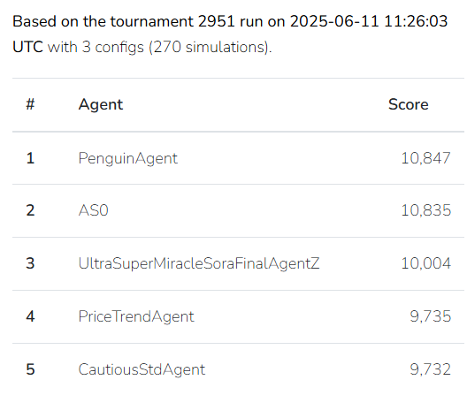
Experimental Results
Mean Scores of Agents in the Tournament
 | 50 steps | 100 steps | 200 steps
PriceTrendAgent | 1.0109 | 0.9914 | 0.8103
CautiousStdAgent | 1.0020 | 0.9803 | 0.8102
Last online tournament
on June 11, 2025
PriceTrendAgent is ranked 4th,
outperforming the base agent
PenguinAgent
PriceTrendAgent
CautiousStdAgent
Notes:
We tested our agent in the online tournament held on June 11, 2025.
PriceTrendAgent ranked 4th, which is better than the base agent.
実験結果と締切時の最終結果
Cautiousから改善されたこと中心の内容
Penguinに触れるべきかどうか

Slide 14
Conclusions
We developed PriceTrendAgent based on CautiousStdAgent.
PriceTrendAgent uses partner scoring and proposal adjustments based on market trends.
Future work includes adopting forward-looking strategies and optimizing the parameters.
Notes:
In conclusion, we developed PriceTrendAgent based on CautiousStdAgent.
We added partner scoring using trade prices and quantities, and proposal adjustments based on market trends
Future work includes incorporating forward-looking strategies and parameter tuning to improve performance.
Thank you for your attention.
まとめ
PriceTrendStdAgentをCautiousStdAgentを参考に改良した．
改良点は交渉相手を価格，量の双方向からのスコア評価，トレンド価格推測をもとにした交渉．
実験から，短い期間において改善が見られた
未来を見据えた交渉やパラメータの最適化が今後の課題である．

Slide 15
PriceTrendAgent Improvements (1/2)
Improvements
Partner scoring
  After each successful trade, it updates a quantity- and price-based partner score to guide later negotiations.
Market trend prediction
  It uses an exponential moving average (EMA) of market prices to predict subsequent movement.
Trend-aware proposal adjustments
  It adjusts proposal quantity and timing based on the predicted price movement.
Notes:
This slide summarizes the improvements.
There are three key points.
First, partner scoring.
After each successful trade, we update the partner’s score based on price and quantity.
We use that score to rank partners and guide later negotiations.(E)
Second, market trend prediction.
At each step PriceTrendAgent uses an exponential moving average (EMA) of market prices and labels the trend by comparing the latest price to the EMA.(E)
Third, trend-aware proposal adjustments.
Using that trend, the agent adjusts proposal quantity and timing.

Slide 16
Strategy of CautiousStdAgent
The agent adjusts buying and selling based on
stock levels and step.
Buying strategy:
  It accepts only same-day offers with acceptable price and quantity.
  It automatically rejects all offers scheduled for future steps.
Selling strategy:
  It ranks selling partners by total past traded quantity and prioritizes sales in that order.
Notes:
Before introducing our improvements, we review the strategy of CautiousStdAgent.
The agent bases its decisions on inventory, so it changes buying and selling based on the stock levels and step.(E)
If the agent is buyer, it only accepts same-day offers with good price and quantity.
It rejects future offers automatically.(E)
If the agent is the seller, it chooses offer sets that maximize revenue without exceeding inventory.
It ranks selling partners by total past traded quantity and prioritizes sales in that order.
CautiousStdの戦略
現在ステップであることと在庫数にマッチしているかで決定
買い手：当日納品の提案に対してのみ価格と量の確認をして，制約を満たしていれば受諾．
売り手：後半在庫が余れば，より取引をしている相手に優先分配

Slide 17
Experimental Results
Last online
tournament
on June 11, 2025
PriceTrendAgent is ranked 4th,
outperforming the base agent
PenguinAgent
PriceTrendAgent
CautiousStdAgent
Notes:
We tested our agent in the online tournament held on June 11, 2025.
PriceTrendAgent ranked 4th, which is better than the base agent.
However, it did not surpass PenguinAgent, the winning agent of last year’s competition.
実験結果と締切時の最終結果
Cautiousから改善された

