Slide 1
Rchan: A Strategy for
SCML 2025 OneShot Track
Shota Takayama
Fujita Lab,
Tokyo University of Agriculture and Technology
Notes:
Hello everyone. My name is Shota Takayama. Today, I will introduce my negotiation agent, Rchan, which I developed for the SCML 2025 OneShot Track.

Slide 2
Concepts

Slide 3
Concepts
What is Rchan Concepts?
  An autonomous agent based on last year's winner, "Cautious OneShot Agent".
  Key Idea 1:
    Learns from past negotiations to find the best partners.
  Key Idea 2:
    Makes adaptive decisions by accepting offers that maximize profit, not just quantity.
Notes:
Rchan is an autonomous agent based on last year's winner.
It has two key concepts.
First, it learns from past negotiations to find the best partners.
Second, it makes decisions based on maximizing profit, not just matching the quantity.
Now, let me explain how it works.

Slide 4
The Negotiation Environment
SCML Oneshot track is a many-to-many negotiation
  Our agent must negotiate with multiple partners at the same time.
This requires two key decisions in every round:
  Proposal Strategy: What offer should we send to each partner?
  Acceptance Strategy: Which combination of offers from all partners should we accept?
Rchan's core strategy is designed to answer these two questions.
Notes:
First, it's important to understand the negotiation environment of SCML Oneshot track.
This is a many-to-many negotiation. Our agent must negotiate with multiple partners at the same time.
This means that in every round, our agent has to make two key decisions.
First is the Proposal Strategy: what offer should we send to each of these partners?
Second is the Acceptance Strategy: which combination of offers from all partners should we accept?
Rchan's core strategy is designed to answer these two questions.

Slide 5
2. Rchan's Core Idea

Slide 6
Rchan's Core Strategy
Our strategy is divided into two parts:
1. Predictive Proposing Strategy:
      What offer should we send to each partner?
2. Profit-Maximizing Acceptance Strategy:
      Which set of offers from all partners should we accept?
Notes:
As I mentioned, Rchan's core strategy is divided into two parts to address these challenges: Predictive Proposing Strategy and Profit-Maximizing Acceptance Strategy.
First, I will explain our Predictive Proposing Strategy.

Slide 7
Predictive Proposing Strategy
Our proposal strategy has 4 steps:
Track History
Estimate Probabilities
Find "Best Partners"
Propose the Best Combo
Let's look at each step.
Notes:
Our Predictive Proposing Strategy has four simple steps
First, we Track History. Second, we Estimate Probabilities. Third, we Find our Best Partners. And finally, we Propose the Best Combo.
Let's look at each step.

Slide 8
Step 1: Track History
We record every offer we make to every agent.
For each agent, we maintain a history log.
This log tracks the quantity we proposed and whether it was accepted or not.
For Example: Partner-A history log
Quantity | 1 | 2 | 3 | … | 7
Offers | 20 | 5 | 10 | … | 2
Acceptances | 14 | 0 | 8 | … | 1
Notes:
Step one is to track history.
We record every offer we make to every agent.
For each agent, we maintain a history log.
This log tracks the quantity we proposed and whether it was accepted or not.

Slide 9
Step 1: Track History
We record every offer we make to every agent.
For each agent, we maintain a history log.
This log tracks the quantity we proposed and whether it was accepted or not.
For Example: Partner-A history log
Quantity | 1 | 2 | 3 | … | 7
Offers | 20 | 5 | 10 | … | 2
Acceptances | 14 | 0 | 8 | … | 1
Notes:
For example, as you can see in the table, we offered a quantity of 1 to Partner A, 20 times, and it was accepted 14 times.

Slide 10
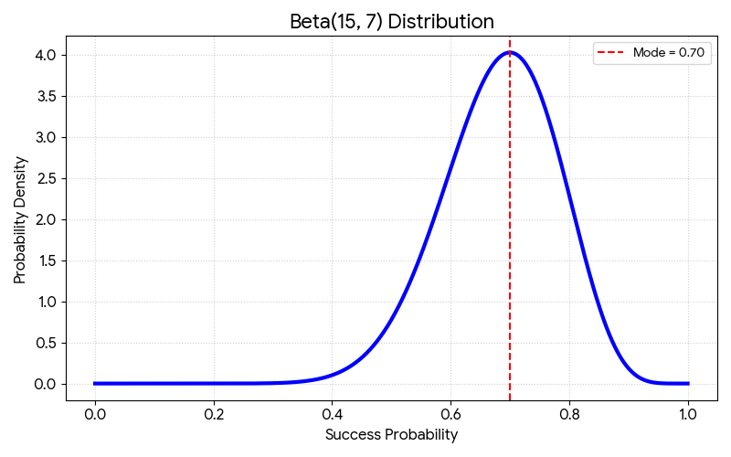
Step 2: Estimate Probabilities
From this history, we predict the acceptance probability of our next offer
using a Beta distribution model.
For Example: For Quantity = 1
Quantity | 1
Offers | 20
Acceptances | 14
P(quantity = 1) = Beta(15, 7)
Successes (α): 14 + 1 = 15
Failures (β): (20 - 14) + 1 = 7
Notes:
Step two is to Estimate Probabilities.
From this history, we predict the acceptance probability for our next offer using a Beta distribution model
For example, with 20 offers and 14 acceptances, we create a Beta distribution model. In this case, it is Beta(15, 7).
This graph shows our belief about the acceptance rate. As you can see, the most likely probability is around 0.7, or 70%."

Slide 11
Step 2: Estimate Probabilities
The model gives us an acceptance probability for offering a certain quantity to a specific agent
For Example: Partner-A history log
Quantity | 1 | 2 | 3 | … | 7
Offers | 20 | 5 | 10 | … | 2
Acceptances | 14 | 0 | 8 | … | 1
Notes:
The model gives us a acceptance probability for offering a certain quantity to a specific agent.

Slide 12
Step 2: Estimate Probabilities
We apply this same calculation to every quantity in our history log.
For each quantity, we create a different Beta distribution model based on its own history of acceptances.
For Example: Partner-A history log
Quantity | 1 | 2 | 3 | … | 7
Offers | 20 | 5 | 10 | … | 2
Acceptances | 14 | 0 | 8 | … | 1
Beta(15, 7)
Beta(1, 6)
Beta(9, 3)
Beta(2, 2)
Notes:
We apply this same calculation to every quantity in our history log.
So, for each quantity, we create a different Beta distribution model based on its own history of acceptances.
This allows us to build a detailed profile for each partner.

Slide 13
Step 2: Estimate Probabilities
This model transforms our simple history log into a powerful probability table
This table is the key to our strategy, allowing us to make data-driven decisions.
For Example: Partner-A history log
Quantity | 1 | 2 | 3 | … | 7
Offers | 20 | 5 | 10 | … | 2
Acceptances | 14 | 0 | 8 | … | 1
Beta(15, 7)
Beta(1, 6)
Beta(9, 3)
Beta(2, 2)
Probabilities | 0.75 | 0.1 | 0.7 | … | 0.4
Notes:
As a result, our simple history table is transformed into a powerful probability table.
Now, we have a predicted acceptance rate for every quantity we might offer to this partner.
This table is the key to our strategy, allowing us to make data-driven decisions.

Slide 14
Step 3: Find "Best Partners"
We rank partner by their overall acceptance rate to find the most reliable partners.
We then select the Top 4 agents to focus on.
For Example: Partners history log
Partner | A | B | C | D | E | F
Total Offers | 50 | 10 | 30 | 40 | 50 | 30
Total Acceptances | 40 | 3 | 15 | 30 | 10 | 3
Acceptance rate | 0.8 | 0.3 | 0.5 | 0.75 | 0.2 | 0.1
Notes:
Step three is to find our 'best partners'.
We rank agents by their overall acceptance rate to find the most reliable partners.
Then, we select the Top 4 most reliable agents.

Slide 15
Step 3: Find "Best Partners"
We rank agents by their overall acceptance rate to find the most reliable partners.
We then select the Top 4 agents to focus on.
For Example: Partners history log
Partner | A | B | C | D | E | F
Total Offers | 50 | 10 | 30 | 40 | 50 | 30
Total Acceptances | 40 | 3 | 15 | 30 | 10 | 3
Acceptance rate | 0.8 | 0.3 | 0.5 | 0.75 | 0.2 | 0.1
Notes:
In this example, we select Partners A, D, C, and B as our best partners.

Slide 16
Step 4: Propose the Best Combo
We find the best combination of offers for our Top 4 partners.
We calculate the Expected Value for many different combinations.
  Expected Value = Quantity × Predicted Probability
Combination Example: (A, B, C, D) = (3, 1, 4, 2)
Partner | A | B | C | D
Quantity | 3 | 1 | 2 | 4
Probabilities | 0.7 | 0.9 | 0.5 | 0.8
Expected Value | 2.1 | 0.9 | 1.0 | 3.2
Notes:
The final step is to propose the best combo.
For our top 4 agents, we calculate the expected value for many different combinations.
The expected value is the quantity multiplied by its predicted probability.
Let's look at the first column for Partner A as an example.
In this specific combination, we consider offering a Quantity of 3 to Partner A.
From our previous step, we know the Probability of this offer being accepted is 0.7.
So, the Expected Value for this single offer is the Quantity times the Probability, which is 2.1.

Slide 17
Step 4: Propose the Best Combo
We do this for all possible combinations, and Rchan chooses the one with a total expected value that is closest to our target
Combination Example: (A, B, C, D) = (3, 1, 4, 2)
Partner | A | B | C | D
Quantity | 3 | 1 | 2 | 4
Probabilities | 0.7 | 0.9 | 0.5 | 0.8
Expected Value | 2.1 | 0.9 | 1.0 | 3.2
total expected value = 7.2
Notes:
In this case, the total expected value is 7.2.
We do this for all possible combinations, and Rchan chooses the one with a total expected value that is closest to our target

Slide 18
Predictive Proposing Strategy
Our proposal strategy has 4 steps:
Track History
Record all offers
Estimate Probabilities
Calculate the acceptance probabilities
Find "Best Partners"
Rank and select Top 4
Propose the Best Combo
Maximize expected value
This four-step process makes our proposals both smart and effective.
Notes:
So, let me quickly summarize the proposing strategy.
It's a simple four-step process.
First, we track the history.
Based on that data, we estimate the acceptance probabilities.
This allows us to find our top 4 best partners.
And finally, we propose the best combination to them.
This process is what makes our proposals so effective.

Slide 19
Profit-Maximizing Acceptance Strategy
We accept offers based on profit, not just quantity.
Problem:
  Getting too little or too much can lead to costly penalties.
Rchan's Solution:
  Solution: We calculate a "Profit Score" for every combination of offers.
    Score = Revenue - Costs (like Shortage or Disposal Penalties)
  Rchan accepts the combination with the highest score.
Notes:
Next, I will explain our second strategy: Profit-Maximizing Acceptance.
The key idea is to accept offers based on profit, not just quantity.
Getting too little or too much can be expensive.
So, Rchan calculates a 'Profit Score' for all incoming offers, and simply chooses the combination with the highest score.

Slide 20
3. Conclusion

Slide 21
Conclusion
Rchan is a robust and adaptive agent because:
  Predictive Proposing Strategy:
    It learns from history to find the most reliable partners and make effective offers.
  Profit-Maximizing Acceptance Strategy:
    It uses a profit score to make flexible decisions that adapt to the situation.
Notes:
To conclude, Rchan is a strong agent for two reasons.
First, its Predictive Proposing Strategy strategy learns from history to find the best partners and make effective offers.
Second, its Profit-Maximizing Acceptance strategy uses a profit score to make flexible decisions based on the situation.
These two ideas together make Rchan a very robust and adaptive agent.

Slide 22
Thank you for Listening
Notes:
This concludes my presentation. Thank you for listening.

