Slide 1

CostAverseAgent for SCML2025 oneshot
Yuzuru Kitamura
Tokyo University of Agriculture and Technology
SCML 2025

Slide 2
Contents
Concepts
Proposal Strategy
Acceptance Strategy
Response Strategy

Slide 3
Concepts
Based on BetterSyncAgent.
Ignore price and focus only on quantity to trade.
Averse to paying costs.
  Cost means disposal cost and shortfall penalty.
  In this game, each time a simulation is run, the multipliers for the shortfall penalty and disposal cost for each agent change according to a given probability distribution.
  My agent's primary strategy is to avoid whichever is greater between the shortfall penalty and the disposal cost.

Slide 4

Proposal Strategy
BetterSyncAgent distributes needs at random.(Distribute 1 or more to each.)
3
6 (needs)
1
exougenous contract
my offer
BetterSyncAgent
2
random

Slide 5
Proposal Strategy
Proposal of CostAverseAgent
2
Offers same quantities to all my negotiator.
6 (needs)
2
EpsilonGreedyAgent
2
If needs cannot be distributed equally, distribute the excess to random negotiating partners.
3
7 (needs)
2
EpsilonGreedyAgent
2

Slide 6
Acceptance Strategy
BetterSyncAgent selects the element whose sum of the offered quantities are closest to the needs.
2
offers | Element in Power set of offers | Total offered quantity
2,1,6 | [ ] [2] [1] [6] [2,1] [2,6] [1,6] [2,1,6] | 0 2 1 6 (closest) 3 8 7 9
1
5
6
BetterSyncAgent
Exogenous contract
offer

Slide 7
Acceptance Strategy
CostAverseAgent selects the element whose total offered quantity does not exceed the SDR (shortfall disposal ratio) threshold and is closest to it.
When SDR threshold = 0
2
offers | Element in Power set of offers | Total offered quantity
2,1,6 | [ ] [2] [1] [6] [2,1] [2,6] [1,6] [2,1,6] | 0 2 1 6 (excess) 3 (selected) 8 (excess) 7 (excess) 9 (excess)
1
5
6
CostAverseAgent
(Buy side)
Exogenous contract
offer

Slide 8
Response Strategy
Re-propose to make up the shortfall.
When SDR threshold = 0
2
offers | selected element in Power set of offers | Total offered quantity
2,1,6 | [2,1] | 3 (selected) 2 shortfall
1
5
2
CostAverseAgent
Exogenous contract
Accepted offer
Counter proposal
Notes:
This counter proposal is repeated until sum of the offered quantity match to the needs.

Slide 9
SDR(Shortfall Disposal Ratio)
Definition
  SDR = Shortfall Penalty / Disposal Cost
Interpretation
  Large SDR → High cost if shortfall occurs
  SDR ≈ 1 → Neutral, both costs are comparable
  Small SDR → High cost if disposal occurs
Implication for Decisions
  Large SDR → Avoid accepting excess orders (strict threshold)
  Small SDR → More tolerant to excess orders (looser threshold)
SDR adjusts the acceptance threshold depending on the relative risk of shortfall vs. disposal.

Slide 10
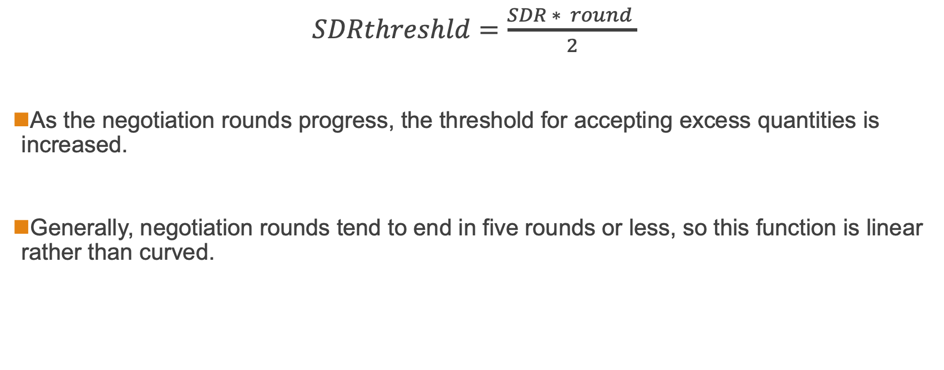
SDR threshold
$SDRthreshld=\frac{SDR ∗ round }{2}$
As the negotiation rounds progress, the threshold for accepting excess quantities is increased.
Generally, negotiation rounds tend to end in five rounds or less, so this function is linear rather than curved.

Slide 11
Acceptance Strategy
CostAverseAgent selects the element whose total offered quantity does not exceed the SDR (shortfall disposal ratio) threshold and is closest to it.
When SDR threshold = 1 , it is able to accept 6 ( = needs + 1)
2
offers | Element in Power set of offers | Total offered quantity
2,1,6 | [ ] [2] [1] [6] [2,1] [2,6] [1,6] [2,1,6] | 0 2 1 6 (selected) 3 8 (excess) 7 (excess) 9 (excess)
1
6
6
CostAverseAgent
(Buy side)
Exogenous contract
offer

