Slide 1

Utility Fit Lookahead Agent – Sequential Multi-deal Negotiation
Work Done By: Garrett Seo, Tri-an Nguyen, Xintong Wang
Presented By: Garrett Seo

Slide 2
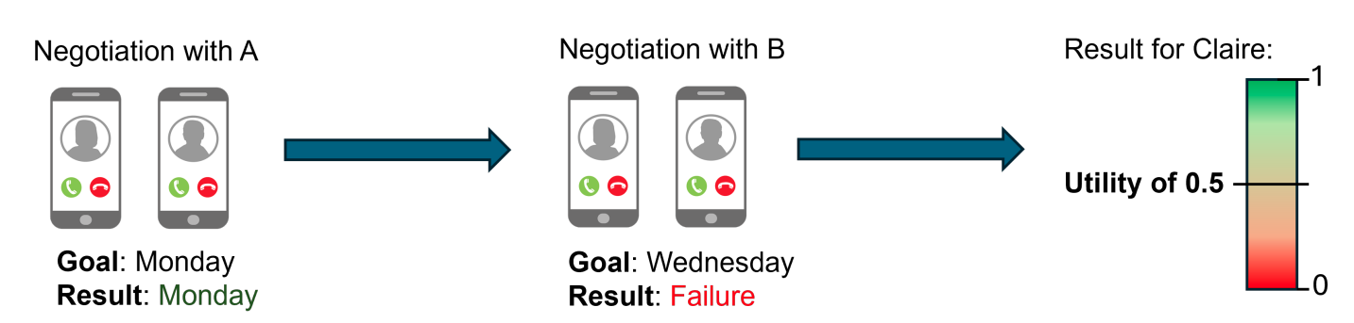
Sequential Multi-Deal Negotiation
Center agent encounters multiple edge agents in sequence
Subnegotiation (center <-> edge): Bilateral, Alternating Offers Protocol
Rewarded for combination of all agreements
Aware of own utility function
  Opponent’s utility function unknown

Slide 3
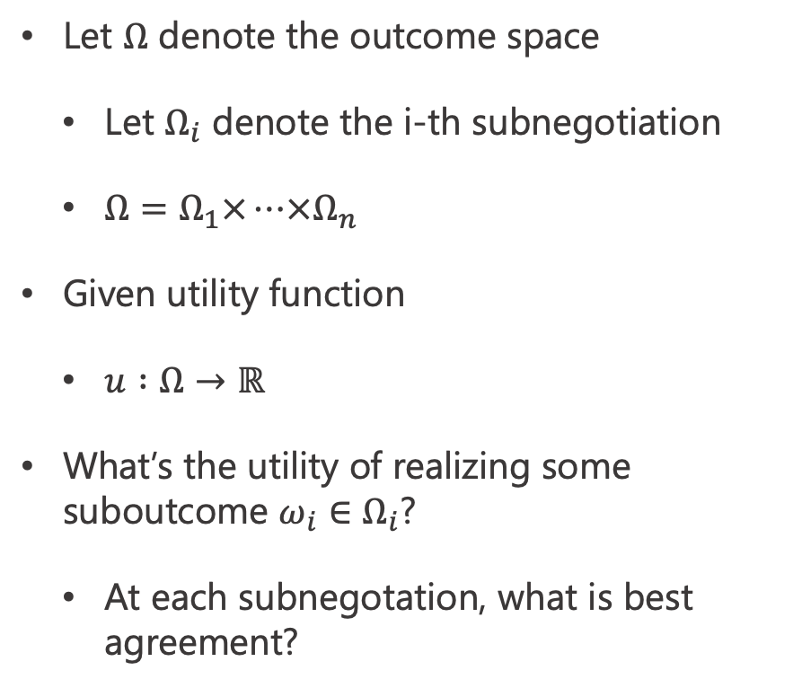
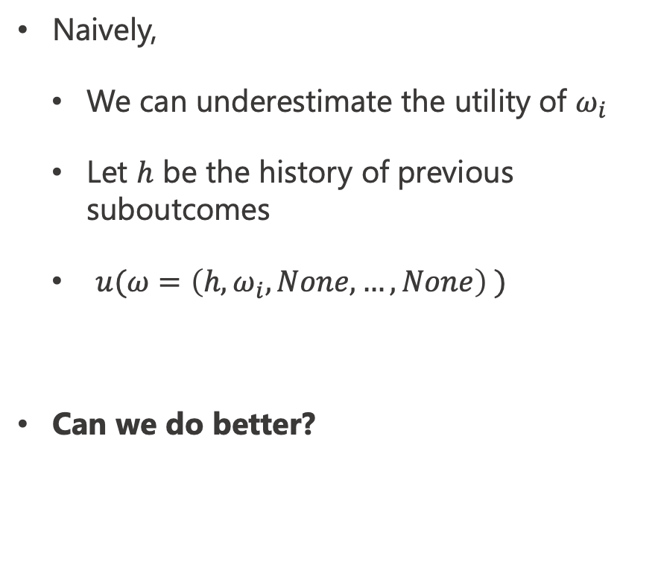
A Look into Subnegotiations
Let $Ω$ denote the outcome space
  Let $Ω_{i}$ denote the i-th subnegotiation
  $Ω=Ω_{1}×…×Ω_{n}$
Given utility function
  $u :Ω→ℝ$
What’s the utility of realizing some suboutcome ${ω_{i}∈Ω}_{i}$?
  At each subnegotation, what is best agreement?
Naively,
  We can underestimate the utility of $ω_{i}$
  Let $h$ be the history of previous suboutcomes
  $u(ω=\left(h, ω_{i}, None, …, None\right) )$
Can we do better?

Slide 4
Our Approach
Divide center strategy in two parts:
Lookahead planning
  Utility estimation
  Early termination
Conceding Strategy
  Utility Fit
    Opponent bids -> our estimated utility

Slide 5

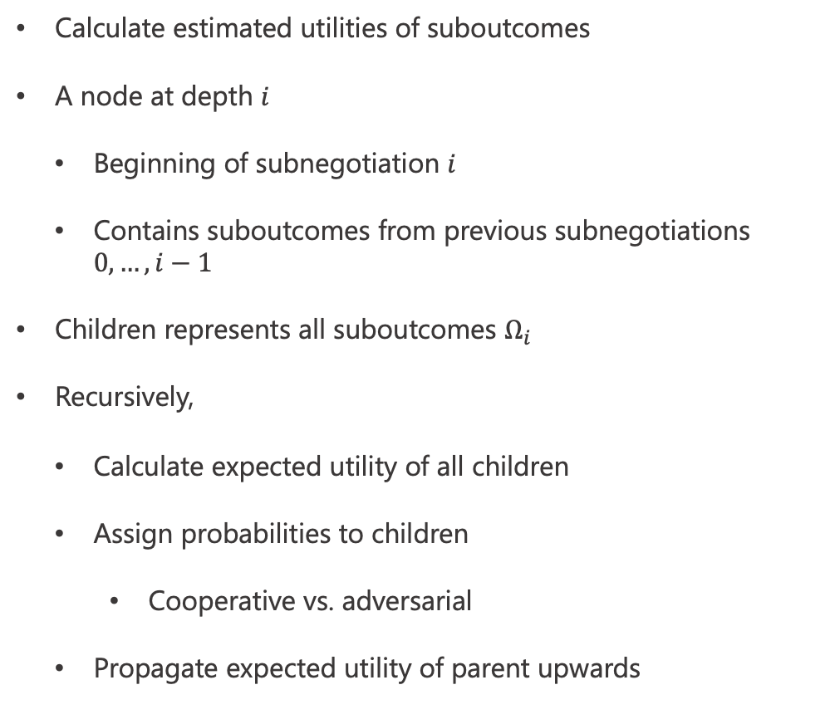





Tree Representation To Solve Estimated Utilities
Calculate estimated utilities of suboutcomes
A node at depth $i$
  Beginning of subnegotiation $i$
  Contains suboutcomes from previous subnegotiations $0, …, i−1$
Children represents all suboutcomes $Ω_{i}$
Recursively,
  Calculate expected utility of all children
  Assign probabilities to children
    Cooperative vs. adversarial
  Propagate expected utility of parent upwards
$$i−1$$
$$i$$
$$p_{1}$$
$$p_{2}$$
$$u_{1}$$
$$u_{2}$$

Slide 6
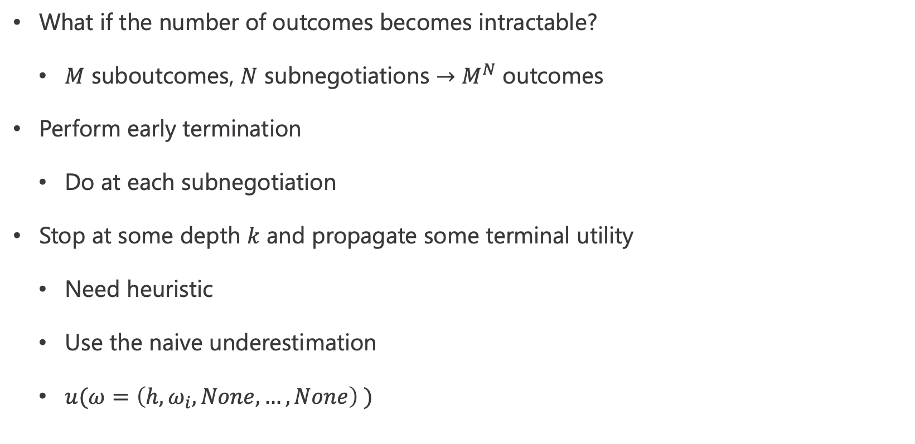
Early Termination
What if the number of outcomes becomes intractable?
  $M$ suboutcomes, $N$ subnegotiations $→$ $M^{N}$ outcomes
Perform early termination
  Do at each subnegotiation
Stop at some depth $k$ and propagate some terminal utility
  Need heuristic
  Use the naive underestimation
  $u(ω=\left(h, ω_{i}, None, …, None\right) )$

Slide 7
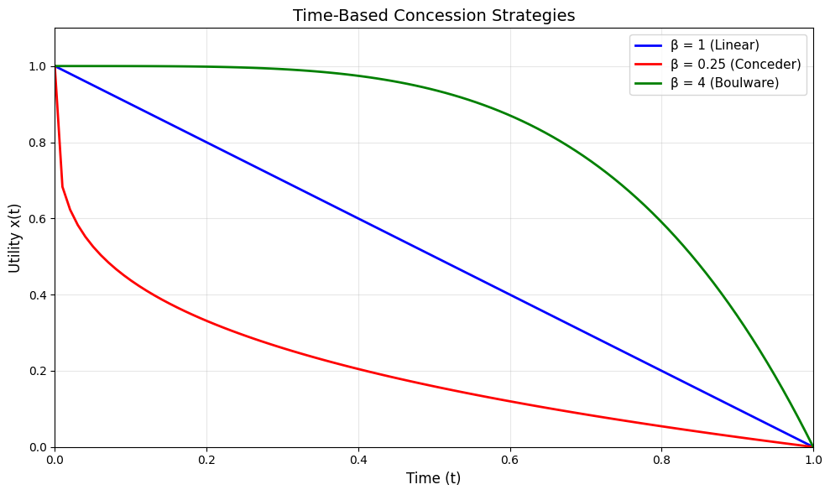
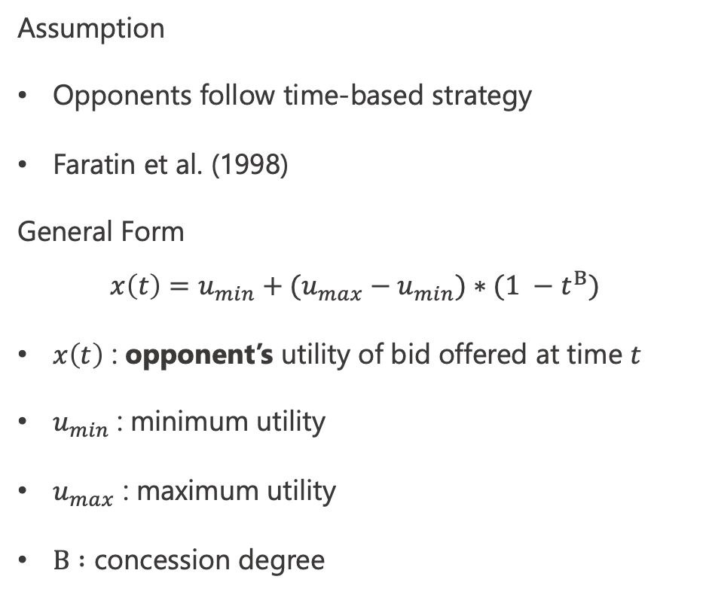
Concession Strategy – Time-Based
Assumption
Opponents follow time-based strategy
Faratin et al. (1998)
General Form
$$x\left(t\right)=u_{min}+(u_{max}−u_{min})∗(1 −t^{Β})$$
$x\left(t\right)$ : opponent’s utility of bid offered at time $t$
$u_{min}$ : minimum utility
$u_{max}$ : maximum utility
$Β :$ concession degree

Slide 8
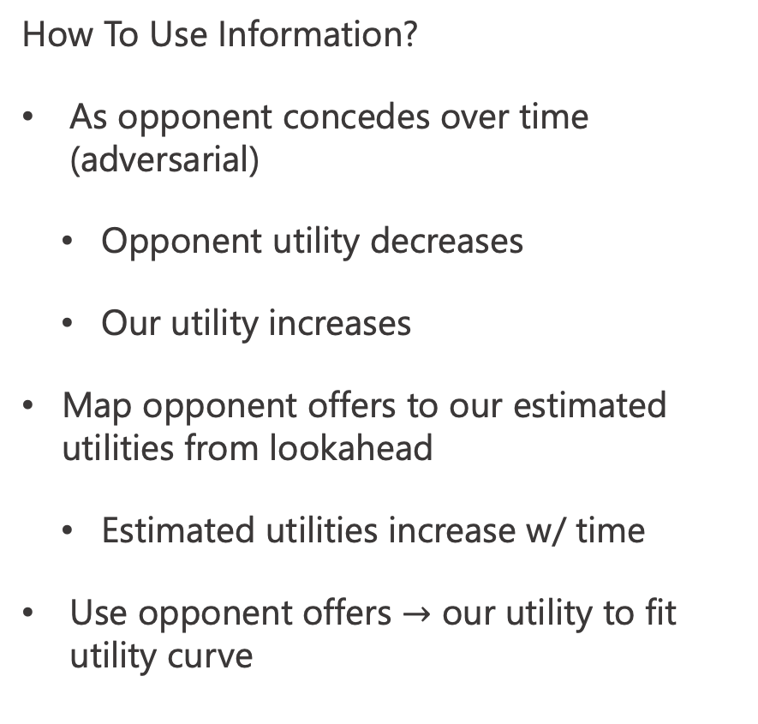
Our Concession Strategy
Idea:
No discount
Delay negotiation as long as possible
  Reject all offers
  Bid suboutcomes with large utility
Make most informed bid at last timestep
  From their offers
How To Use Information?
As opponent concedes over time (adversarial)
  Opponent utility decreases
  Our utility increases
Map opponent offers to our estimated utilities from lookahead
  Estimated utilities increase w/ time
Use opponent offers $→$ our utility to fit utility curve

Slide 9
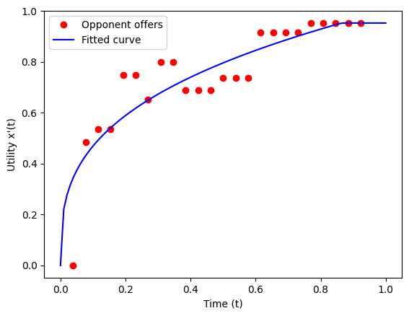
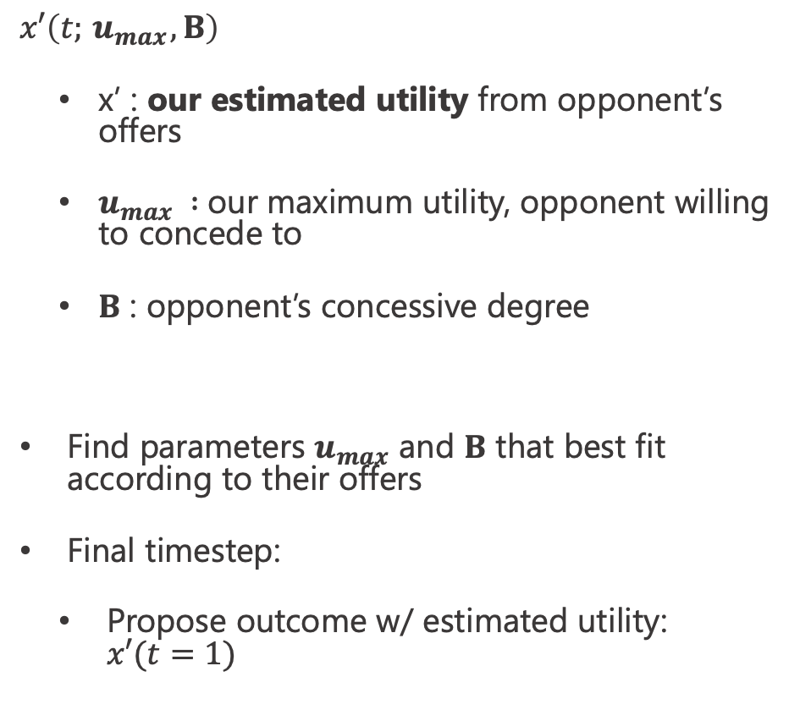
Utility Fit
$$x′\left(t;{ u}_{max},Β\right)$$
  x’ : our estimated utility from opponent’s offers
  $u_{max} :$our maximum utility, opponent willing to concede to
  $Β$ : opponent’s concessive degree
Find parameters $u_{max}$ and $Β$ that best fit according to their offers
Final timestep:
  Propose outcome w/ estimated utility: $x′(t=1)$

